Slide 1
Mashauri Project:
Synopsis:
Analyzing student performance is essential for enhancing teaching methodologies and fostering academic success. By examining factors like sleep duration, social media usage, parental education, dietary habits, and study habits, educators can gain valuable insights into the determinants of academic achievement. Through systematic analysis, patterns and correlations emerge, enabling educators to optimize teaching approaches and provide targeted support to students. This comprehensive understanding allows for tailored interventions, ultimately improving learning outcomes and facilitating student success. Such analysis empowers educators to refine their strategies, thereby creating an environment conducive to continuous improvement and enhanced student achievement.

Slide 2
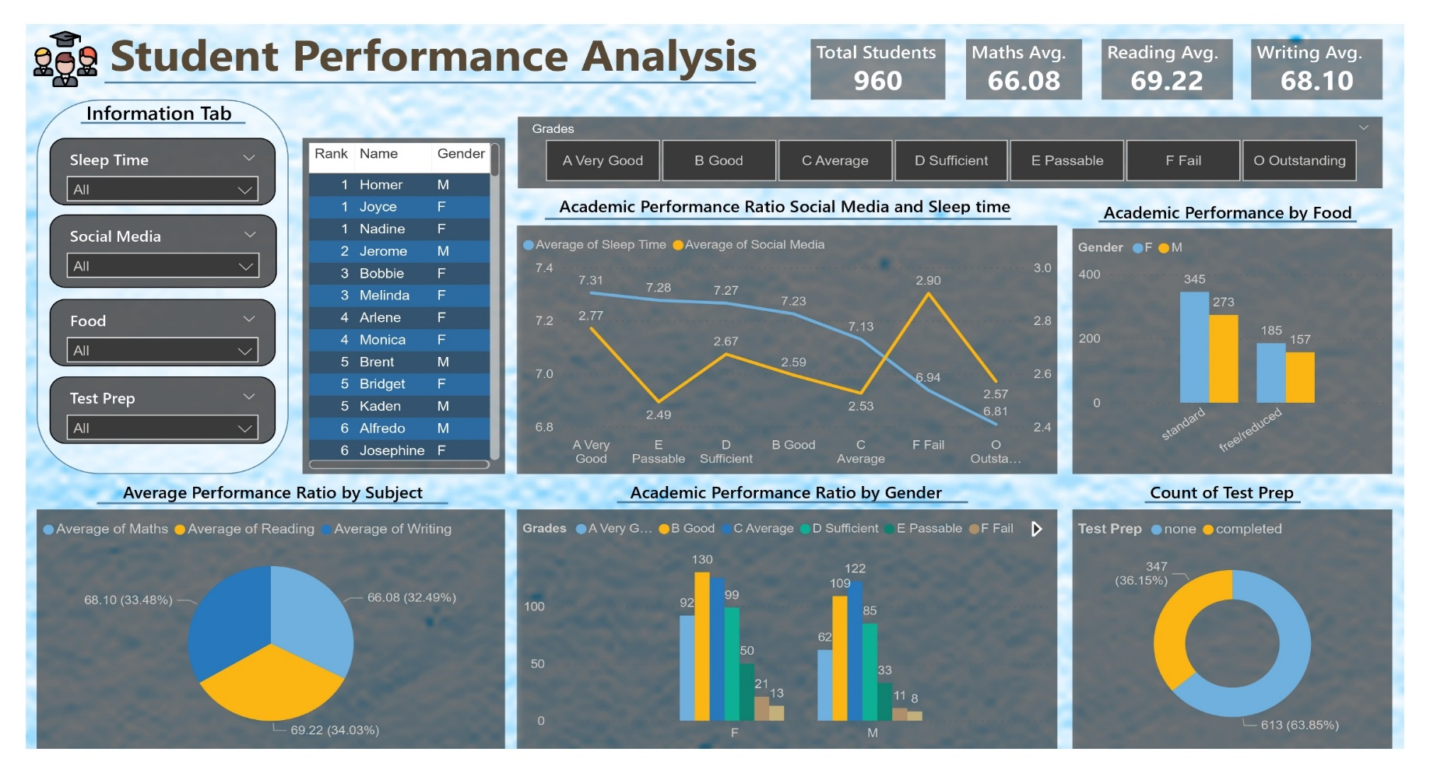
Connecting data source and cleaning data
Importing Dataset and Establishing Connections in Power BI
Establishing Relationships
Table Relationship Formation: Create connection between tables using Names for enhanced data analysis.
Column Establishment: Total Marks, Grade(based on given grading system), Rank, and Percentage columns formulated for comprehensive assessment.
Insights:
Here are some insights derived from the analysis of various factors influencing student performance:
Sleep Time:
Adequate sleep duration positively correlates with academic success.
Students who consistently get enough sleep tend to demonstrate better cognitive abilities and higher grades.
Educators should emphasize the importance of maintaining healthy sleep habits for improved academic performance.
Social Media Engagement:
Excessive social media usage can negatively impact student performance.
Students who spend significant time on social media platforms may experience distractions, reduced study time, and poorer grades.
Encouraging balanced usage and time management strategies could help mitigate the adverse effects of social media on academic achievement.
Food Intake:
Nutritious dietary habits positively influence academic outcomes.
A balanced diet rich in essential nutrients supports brain function, concentration, and energy levels, leading to improved academic performance.
Educators can promote healthy eating habits and provide resources on nutrition to support students' overall well-being and learning.
Test Preparation:
Effective test preparation strategies are crucial for academic success.
Students who engage in thorough and organized test preparation tend to perform better on assessments.
Educators can teach students various study techniques, time management skills, and stress-reduction methods to enhance their test preparation and performance.

Slide 3
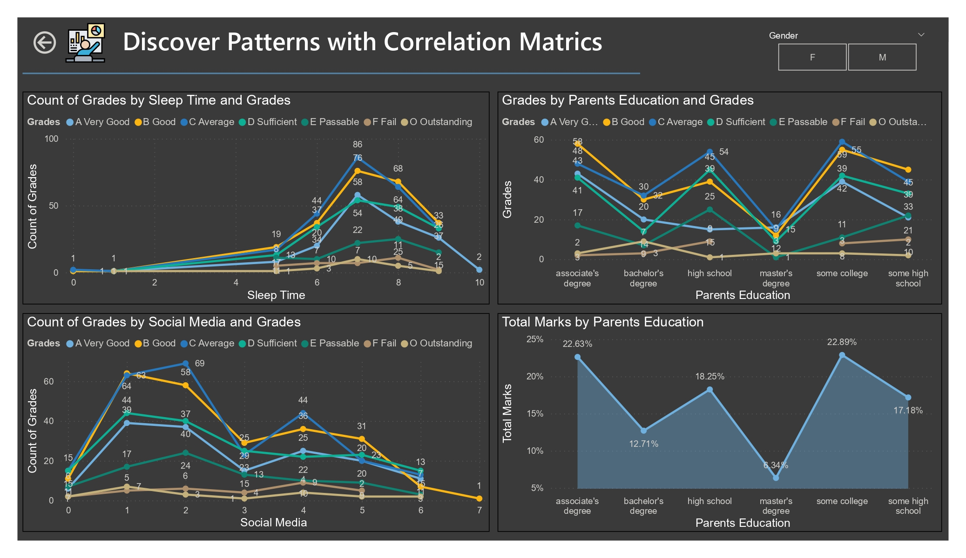
Established the Correlation ship
Between various factors
Here are some insights derived from the analysis of various factors influencing student performance:
Sleep Time:
Adequate sleep duration positively correlates with academic success.
Students who consistently get enough sleep tend to demonstrate better cognitive abilities and higher grades.
Educators should emphasize the importance of maintaining healthy sleep habits for improved academic performance.
Social Media Engagement:
Excessive social media usage can negatively impact student performance.
Students who spend significant time on social media platforms may experience distractions, reduced study time, and poorer grades.
Encouraging balanced usage and time management strategies could help mitigate the adverse effects of social media on academic achievement.
Parental Education:
Higher parental education levels are often associated with better student performance.
Parents with higher education may provide a conducive environment for learning, including access to resources, academic support, and higher expectations for their children.
Collaborating with parents and fostering parental involvement can contribute to enhanced student success.

Slide 4
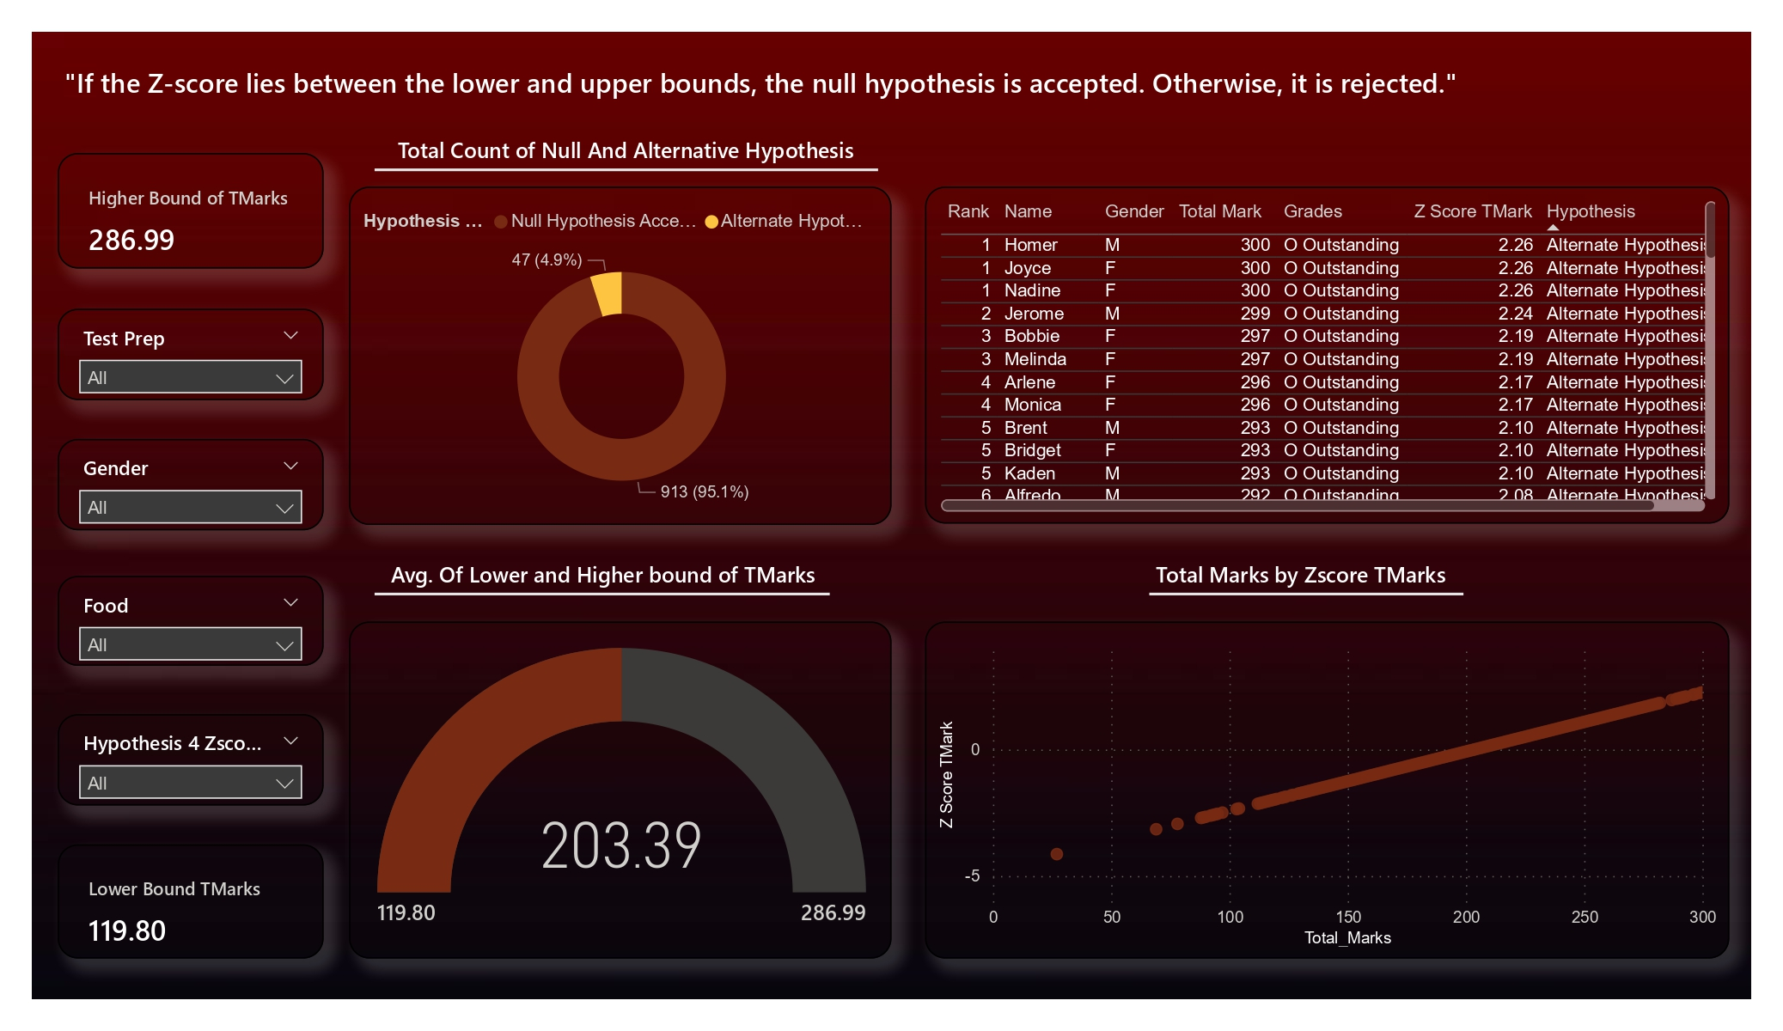
Task 2-Advanced Exploratory Data Analysis in Power BI
Hypothesis Testing Using Two-sample T-tests
Procedure: Created a dataset sample for conducting two-sample T-tests on sleep time and test preparation.
Complex Analysis: Integrated T-distribution table into the dataset for comprehensive statistical evaluations.
Null Hypothesis: Assumed no significant difference in mean sleep time between students who completed test preparation and those who didn’t.
Findings: Accepted the null hypothesis
Correlation Analysis for Interdependencies
Identified that Academic Performance is linked with parental education, food intake, and test preparation. And very weak correlation with categorical variables.
Z-Score Calculation for Total Marks
Objective: Deriving Z-scores for individual total marks to establish lower and upper bounds for inclusion/exclusion criteria.
Purpose: Assessing whether the sample dataset conforms to a bell curve distribution. Also want to find the higher and lower bound of total marks.

Slide 5
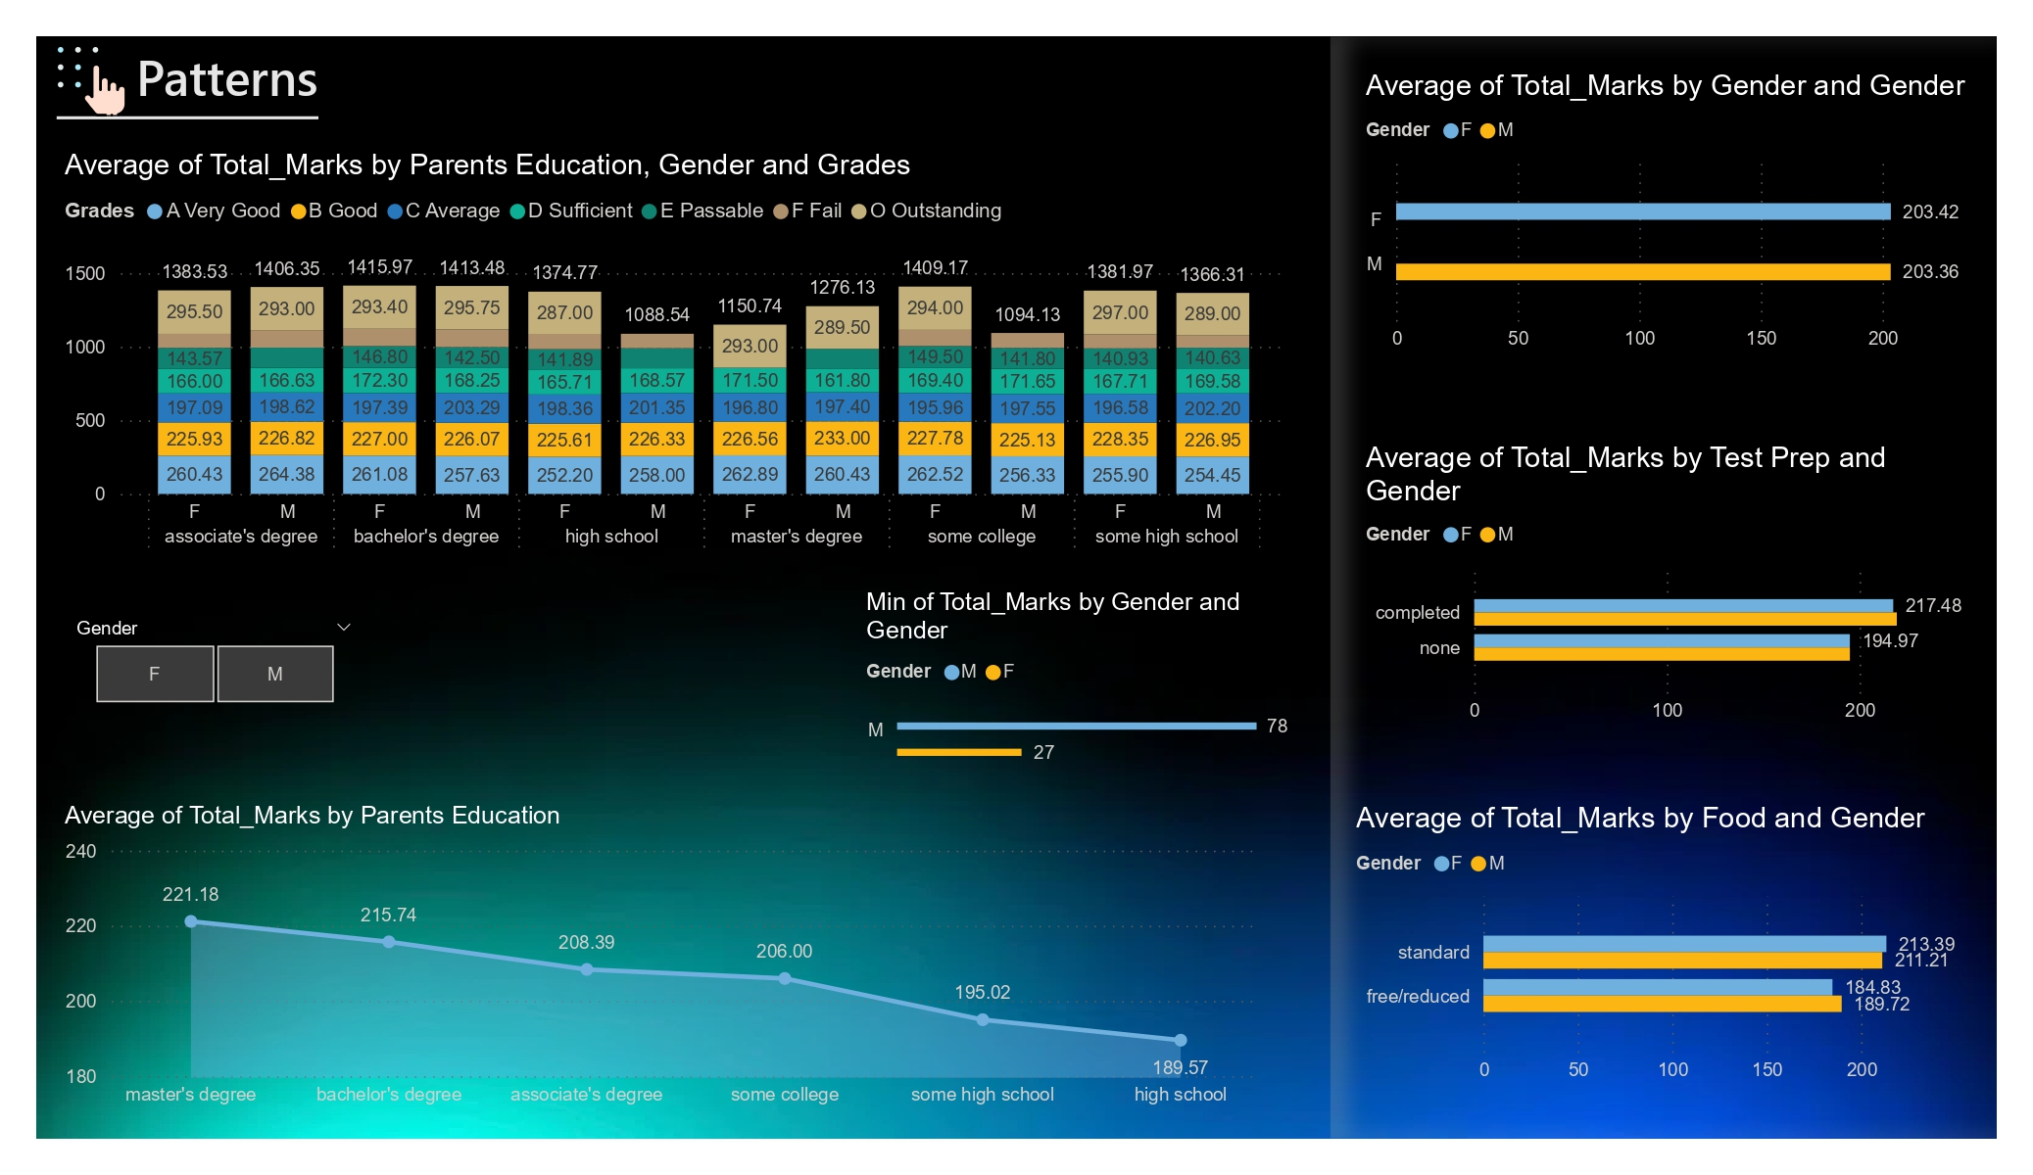
Task 3 -Comprehensive Data Analysis Report

Slide 6
Conclusion for This Project :
In conclusion, analyzing these factors provides valuable insights for educators to optimize teaching strategies, tailor interventions, and provide targeted support to students. By addressing the key determinants of academic success, educators can foster a conducive learning environment, ultimately leading to improved overall learning outcomes and student achievement.
Adequate sleep duration positively correlates with academic success, highlighting the importance of maintaining healthy sleep habits.
Excessive social media engagement may lead to distractions and reduced study time, negatively impacting student performance.
Higher parental education levels are associated with better student outcomes, emphasizing the significance of parental involvement and support in education.
Nutritious dietary habits positively influence academic performance by supporting brain function and energy levels.
Effective test preparation strategies are essential for achieving better academic results, emphasizing the need for students to develop organized study techniques and time management skills.
Overall, addressing these correlations can help educators create a conducive learning environment, leading to improved academic outcomes and student achievement.

